Slide 1




DIGITAL LITERACY
SKILLS
ADVANCED USERS

Slide 2
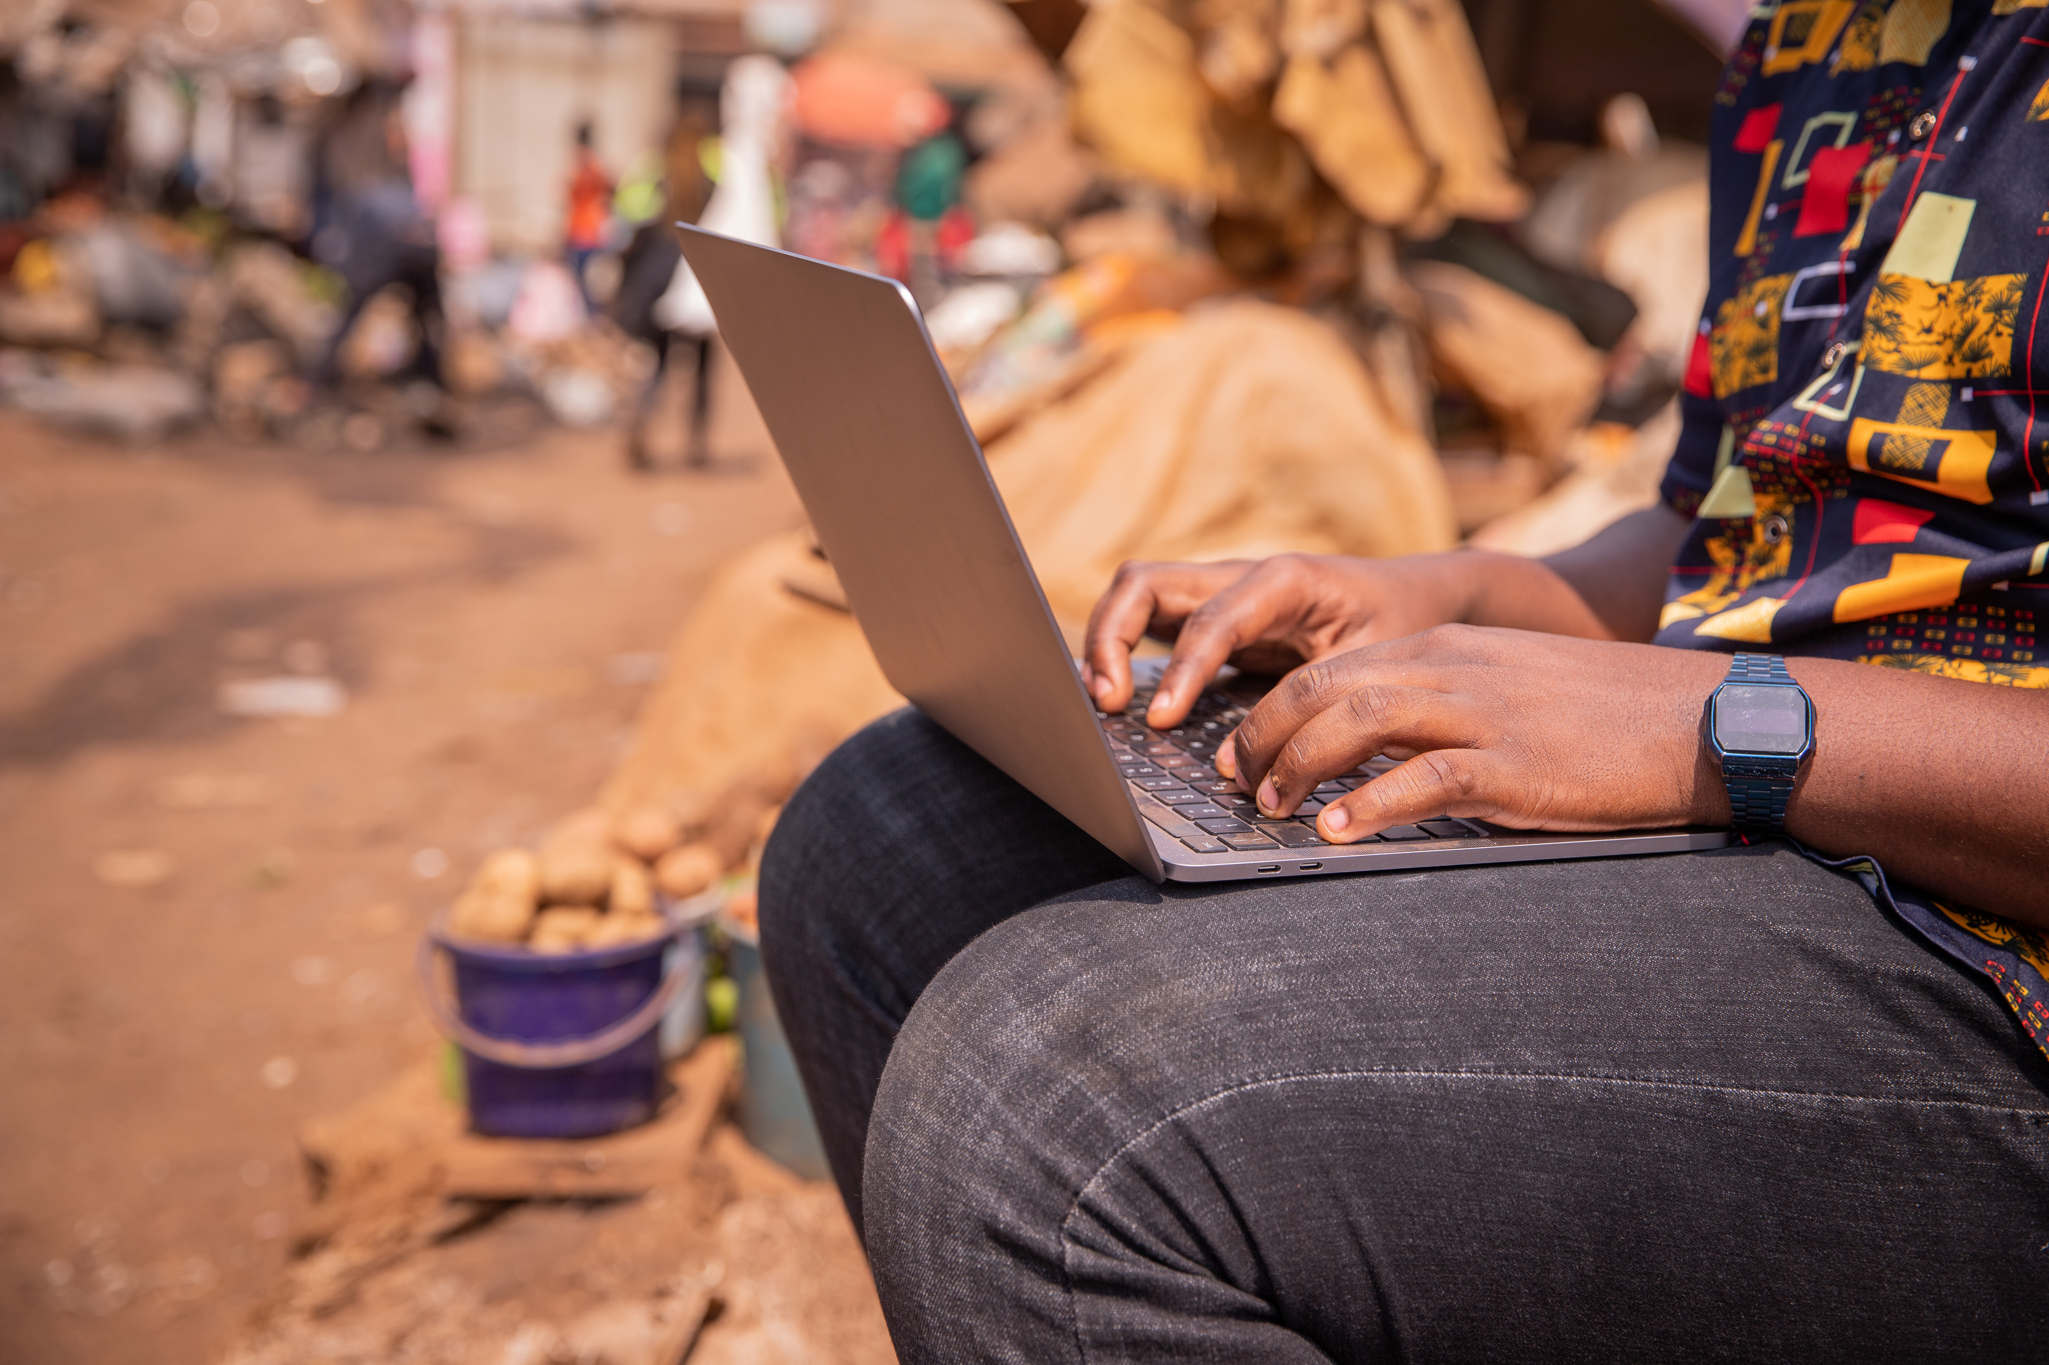
Module 3
Communication
and collaboration

Slide 3

4
Unit 4: Collaborating through digital technologies

Slide 4

Main concepts of digital collaboration
Definition of collaborating through digital technologies:
“to use digital tools and technologies for collaborative processes and for co-construction and co-creation of resources and knowledge.”

Slide 5
Main concepts of digital collaboration
The importance of collaboration through digital technologies
We use digital technologies to:
interact with colleagues, friends, and family
exchange documents, photos, and information
organize work or study (manage tasks or organize meetings).

Slide 6

The most useful tools for online collaboration
Tools that help us to collaborate online with others:
Conferencing and online meeting tools: Skype; GoToMeeting; Zoom Meetings; Google® Meet; Microsoft® Teams
Saving and sharing files: Google Drive; Dropbox; WeTransfer
Schedules and calendars: Google® Calendar; Teamup
Project management: Trello; Redbooth; Asana
Testing opinion: Google® Form.

Slide 7

Security and privacy
Your personal information can be protected by using:
virtual private networks (VPNs)
antivirus programs
strong Passwords.

Slide 8
Skills to practise
Use advanced features of communication tools (e.g., video conferencing, data sharing, application sharing).
As a class, set up a Zoom or Skype meeting that everyone can attend.
Use the meeting to discuss a topic of interest at your school or in your community.
Appoint a group of learners to email an agenda for the meeting.
Appoint a different group of learners to create a Google Doc and to give it a title.
During the meeting allow any learner to open the Google Doc and record points of interest or decisions made.

Slide 9
All back covers should include
contact information of the section
producing the work.
© United Nations Children’s Fund (UNICEF) [month and year of publication]

